Slide 1
Correlation and Analysis of Variance
Mr. Sunanda Das, Assistant Professor, Dept. of CSE, KUET

Slide 2
Correlation
Correlation is the degree of inter-relatedness/associations among the two or more variables.
Correlation analysis is a process to find out the degree of relationship between two or more variables by applying various statistical tools and techniques.
Examples:
Relationship between price and demand of a commodity
Relationship between height and weight

Slide 3
Scope of Correlation Analysis
The existence of correlation between two (or more) variables only implies that these variables:
Either tend to increase or decreased together
An increase (or decrease) in one is accompanied by the corresponding decrease (or increase) in the other.
# Correlation analysis does not answer the questions like why there is cause and effect between two variables.

Slide 4
Types of Correlation
Types of Correlation
On the basis of degree of correlation
On the basis of number of variables
On the basis of linearity
Positive correlation
Negative correlation
Zero Correlation
Simple correlation
Partial correlation
Multiple correlation
Linear correlation
Non – linear correlation

Slide 5
Positive Correlation
When two variables move in the same direction then the correlation between these two variables is said to be Positive Correlation.
When the value of one variable increases, the value of other value also increases at the same rate.
Negative Correlation
In this type of correlation, the two variables move in the opposite direction.
When the value of one variable increases, the value of the other variable decreases.

Slide 6
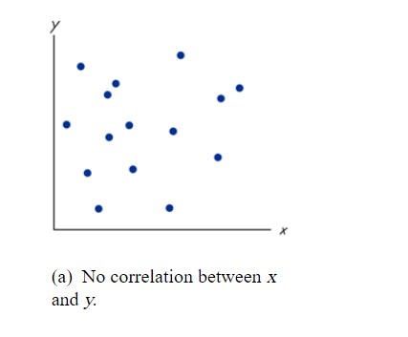
Zero Correlation
When the two variables are independent and the change in one variable has no effect in other variable

Slide 7
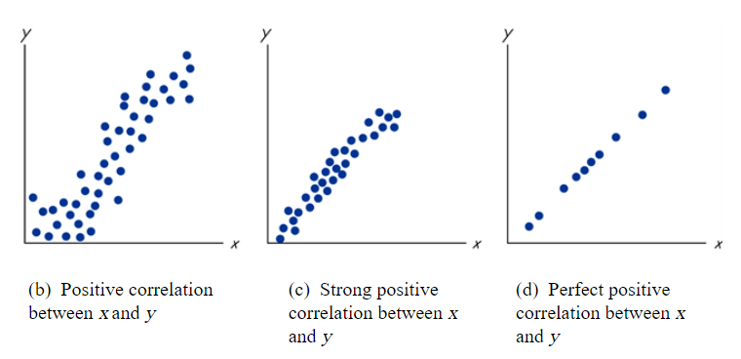

Slide 8
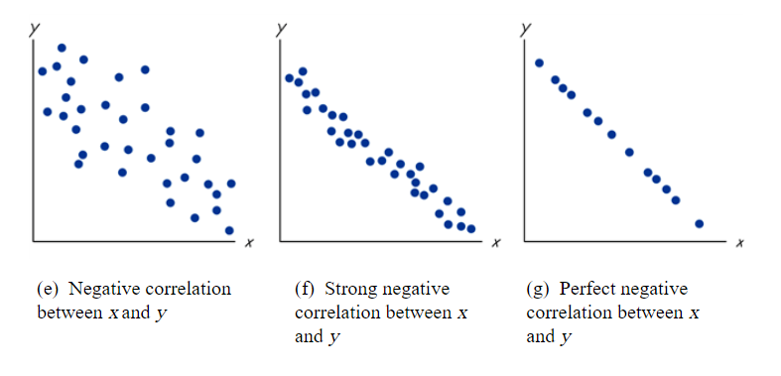

Slide 9
Simple correlation
Correlation is said to be simple when only two variables are analyzed.
Partial correlation
When three or more variables are considered for analysis but only two influencing variables are studied and rest influencing variables are kept constant.
Correlation analysis is done with demand, supply and income. Where income is kept constant.

Slide 10
Multiple correlation In case of multiple correlation three or more variables are studied simultaneously. Rainfall, production of rice and price of rice are studied simultaneously will be known are multiple correlation.
Linear correlation If the change in amount of one variable tends to make changes in amount of other variable bearing constant changing ratio it is said to be linear correlation.

Slide 11
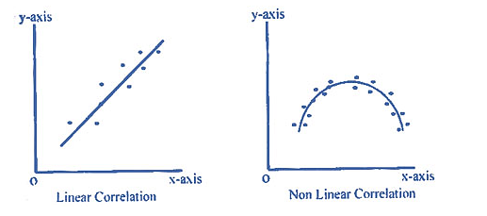
Non - Linear correlation If the change in amount of one variable tends to make changes in amount of other variable but not bearing constant changing ratio it is said to be non – linear correlation.

Slide 12
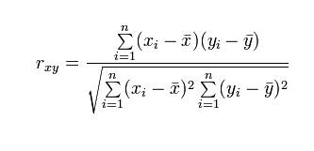
Correlation Coefficient
The correlation coefficient that indicates the strength of the relationship between two variables. Ex. Pearson's correlation coefficient.
i.e In order to test the linear association between two variables x and y we can use the Pearson correlation coefficient r_{xy}

Slide 13
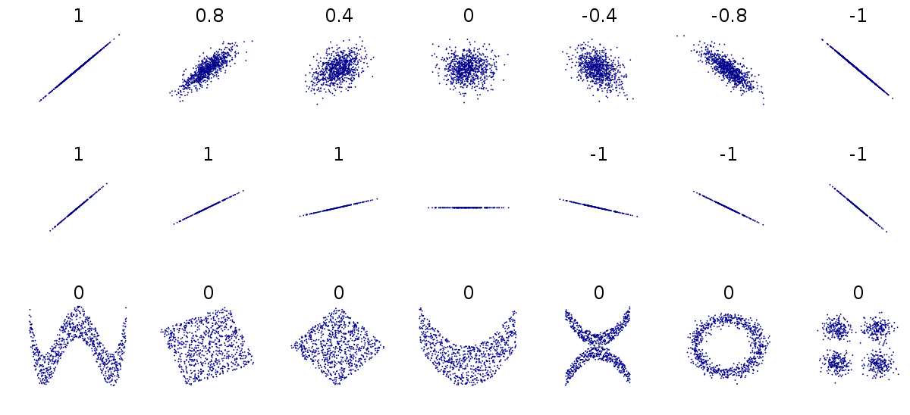
The correlation coefficient takes values between -1 to 1
1: perfect/strong and positive linear correlation
-1: perfect/strong and negative linear correlation
0: no linear correlation
1
0.8
0.4
0
-0.4
-0.8
-1

Slide 14
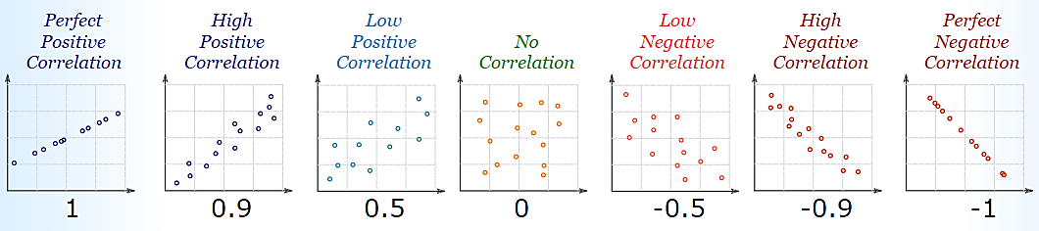
Correlation can have a value:
r = 1 is a perfect positive correlation
r = 0 is no correlation (the values don't seem linked at all)
r = -1 is a perfect negative correlation

Slide 15
SUBJECT | AGE (X) | GLUCOSE LEVEL (Y)
1 | 43 | 99
2 | 21 | 65
3 | 25 | 79
4 | 42 | 75
5 | 57 | 87
6 | 59 | 81

Slide 16
Rank correlation
A rank correlation measures an ordinal association
The relationship between rankings of different ordinal variables or
Different rankings of the same variable, where a "ranking" is the assignment of the ordering labels "first", "second", "third", etc. to different observations of a particular variable.
A rank correlation coefficient measures the degree of similarity between two rankings, and can be used to assess the significance of the relation between them.

Slide 17
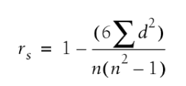
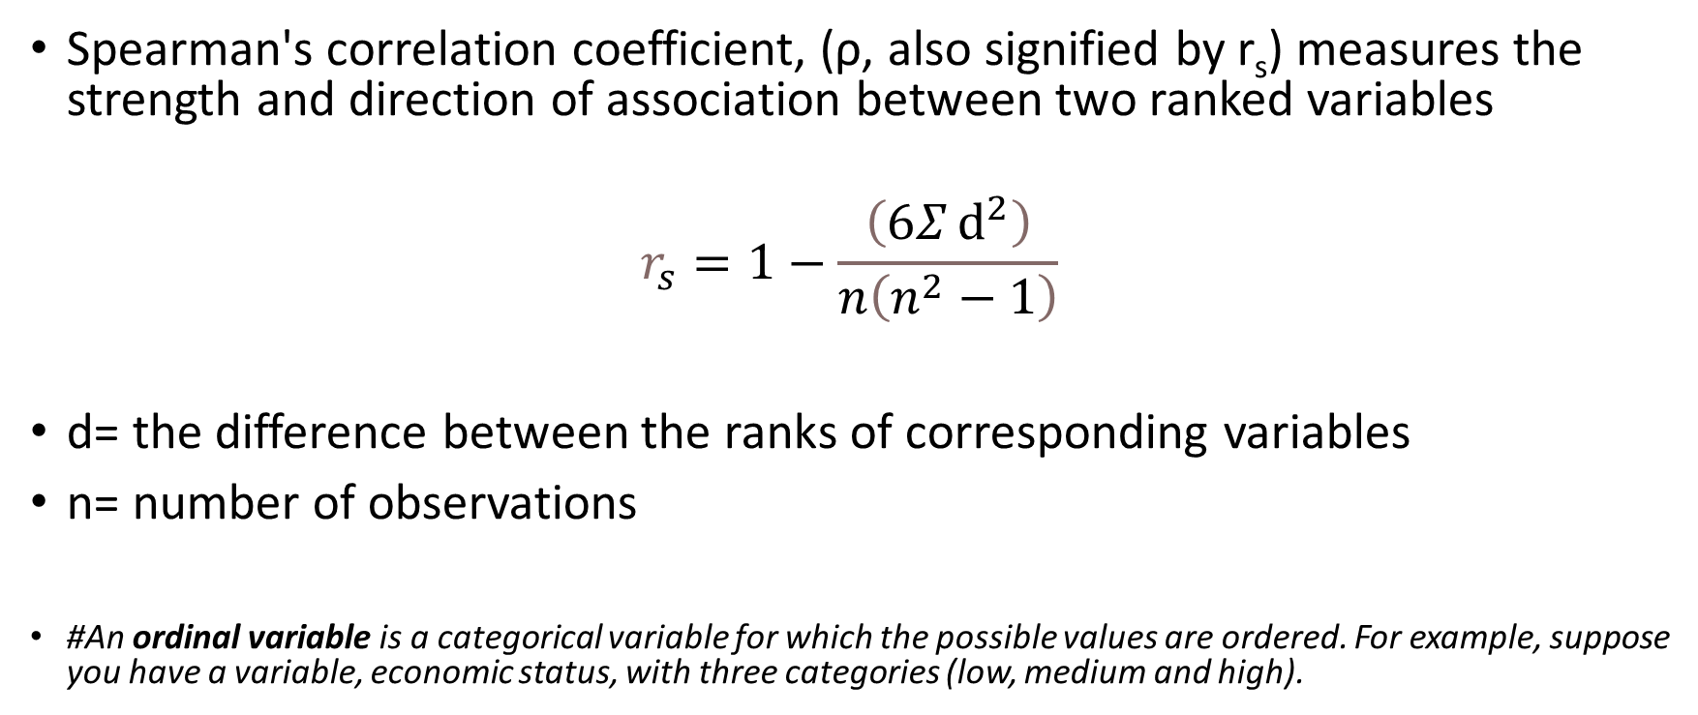
Spearman's rank correlation coefficient
Spearman's correlation coefficient, (ρ, also signified by r_{s}) measures the strength and direction of association between two ranked variables
$$r_{s}=1−\frac{\left(6Σⅆ^{2}\right)}{n\left(n^{2}−1\right)}$$
d= the difference between the ranks of corresponding variables
n= number of observations
#An ordinal variable is a categorical variable for which the possible values are ordered. For example, suppose you have a variable, economic status, with three categories (low, medium and high).

Slide 18
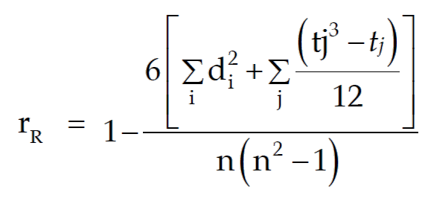
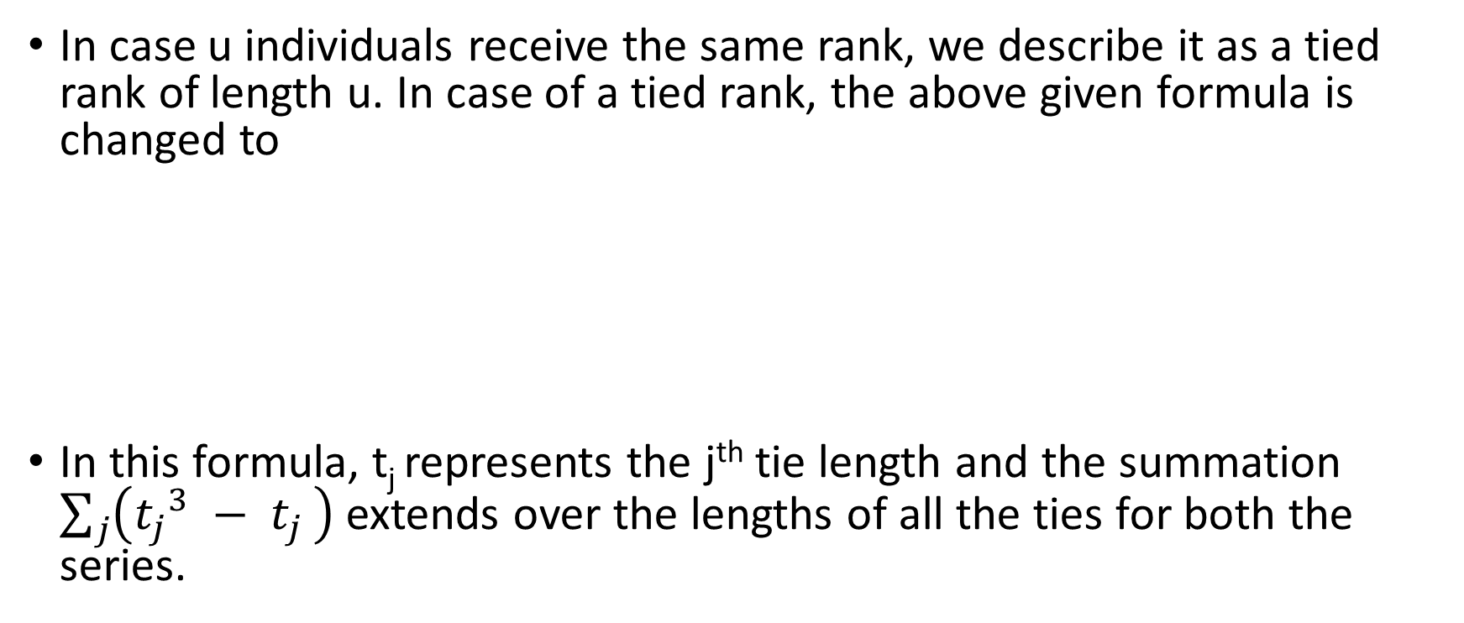
In case u individuals receive the same rank, we describe it as a tied rank of length u. In case of a tied rank, the above given formula is changed to
In this formula, t_{j} represents the j^{th} tie length and the summation $\sum_{j}{\left({t_{j}}^{3} − t_{j }\right)}$ extends over the lengths of all the ties for both the series.

Slide 19
ANOVA (Analysis of Variance)

Slide 20
Analysis of Variance (ANOVA) is a statistical method used to test differences between two or more means.
Hypotheses of a One-Way ANOVA:
The null hypothesis (H₀) is that there is no difference between the groups and equality between means. (Walruses weigh the same in different months)
The alternative hypothesis (H_{a}) is that there is a difference between the means and groups. (Walruses have different weights in different months)

Slide 21
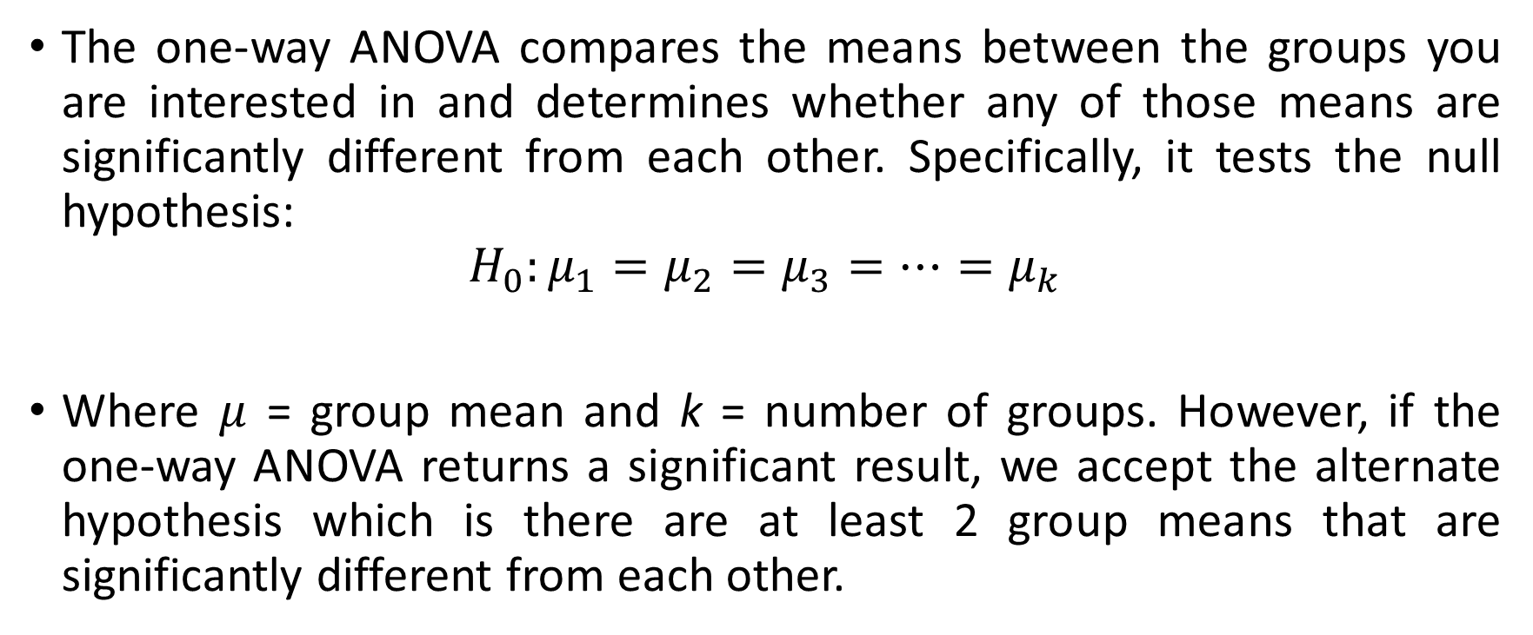
The one-way ANOVA compares the means between the groups you are interested in and determines whether any of those means are significantly different from each other. Specifically, it tests the null hypothesis:
$$H_{0}:μ_{1}=μ_{2}=μ_{3}=…=μ_{k}$$
Where $μ$ = group mean and k = number of groups. However, if the one-way ANOVA returns a significant result, we accept the alternate hypothesis which is there are at least 2 group means that are significantly different from each other.

Slide 22
One-way ANOVA assumption
Two or more independent groups.
Independence in observations, which means that there is no relationship between the observations in each group or between the group themselves.
There should be no significant outliers. Outliers are simply single points within your data that do not follow usual pattern. The problem with outliers is that they can have a negative effect on the one-way ANOVA, reducing the validity of your results.
Dependent variable should be approximately normally distributed for each category of the independent variable.

Slide 23
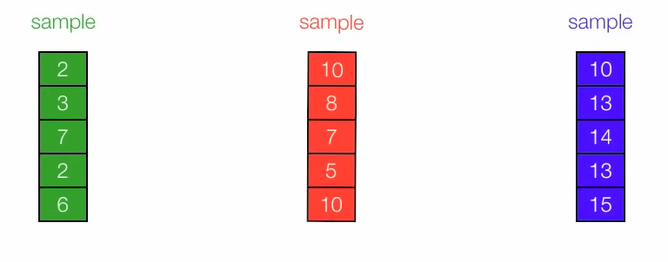

Slide 24
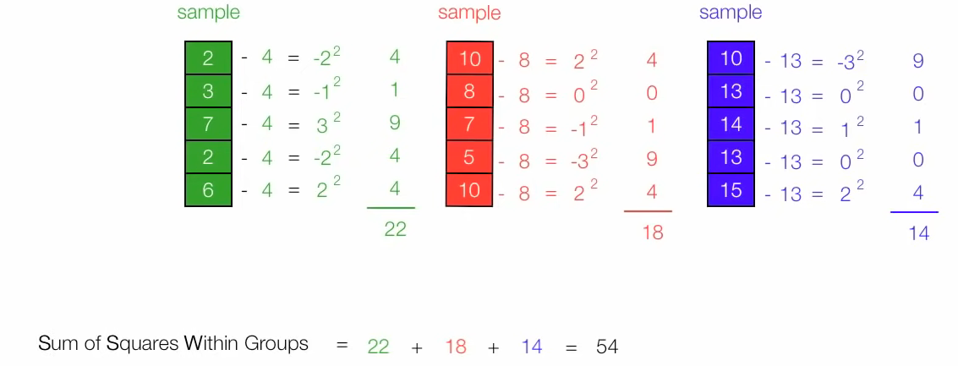
Sum of square within groups

Slide 25
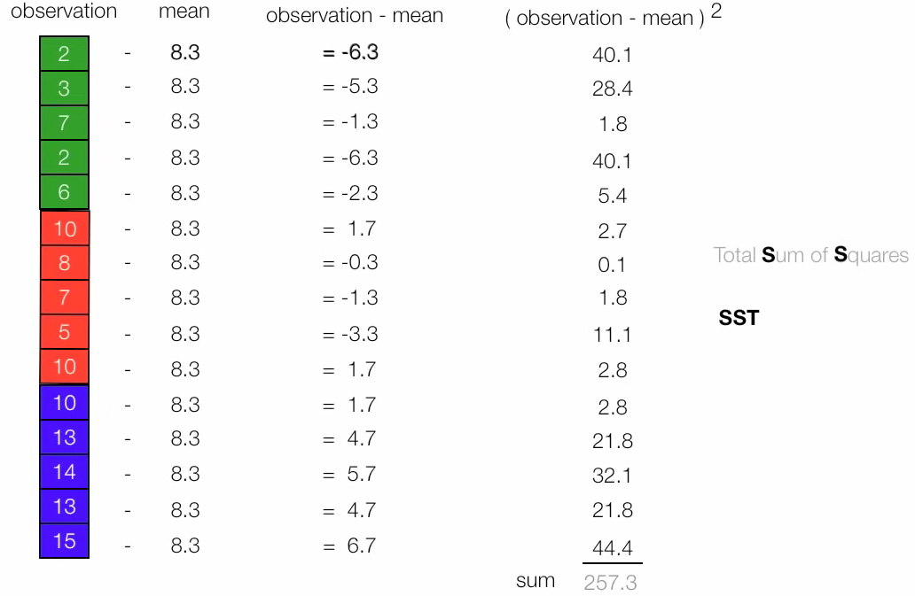
Total SUM of Square

Slide 26
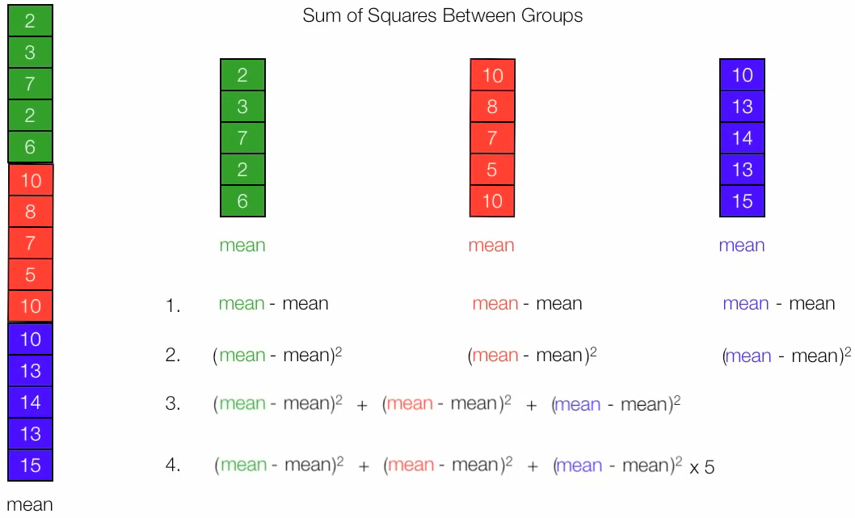

Slide 27
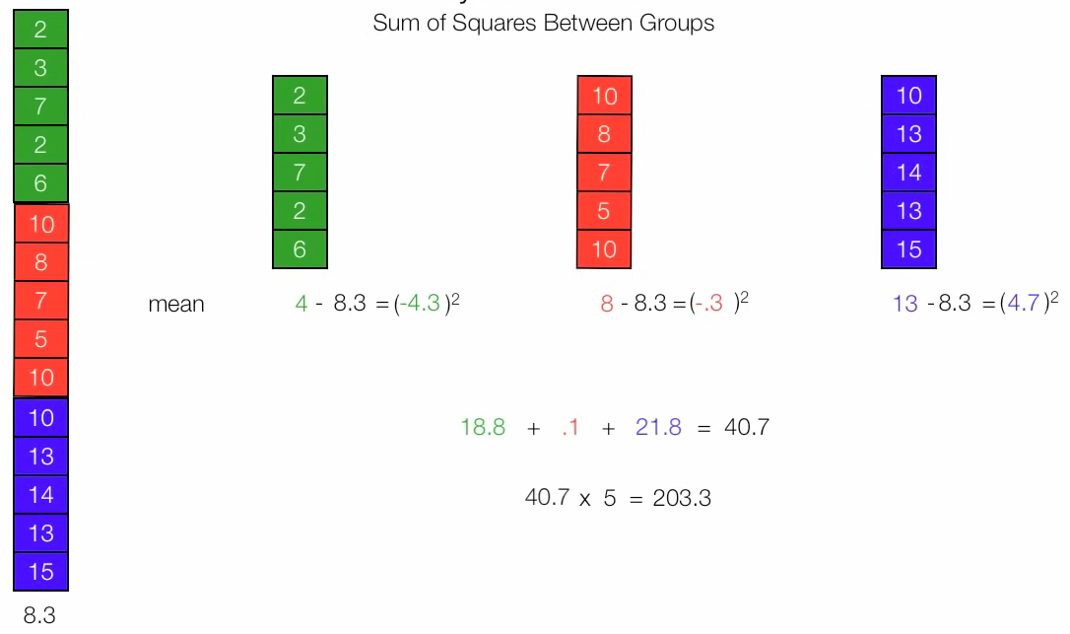
SUM of Square Between Groups

Slide 28
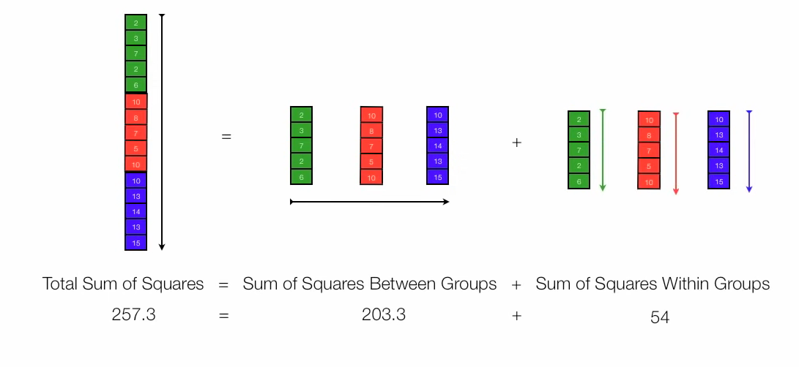

Slide 29
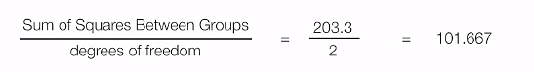
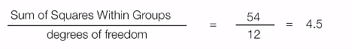
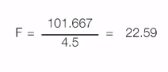
F test
Degree of freedom = no. of groups -1 = 3 -1 = 2
Degree of freedom = Total observations - no. of groups = 15 – 3 = 12

Slide 30
F(2,12) = 22.59, α=0.05 (level of significance)
The significance level, also denoted as alpha or α, is the probability of rejecting the null hypothesis when it is true.
For example, a significance level of 0.05 indicates a 5% risk of concluding that a difference exists when there is no actual difference.

Slide 31
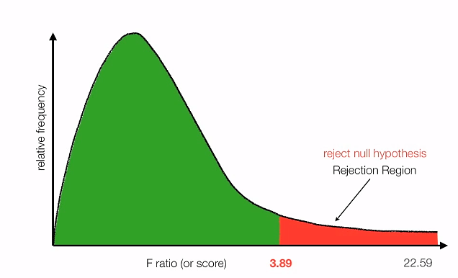
Table of F-statistics α=0.05
Calculate critical value using table

Slide 32
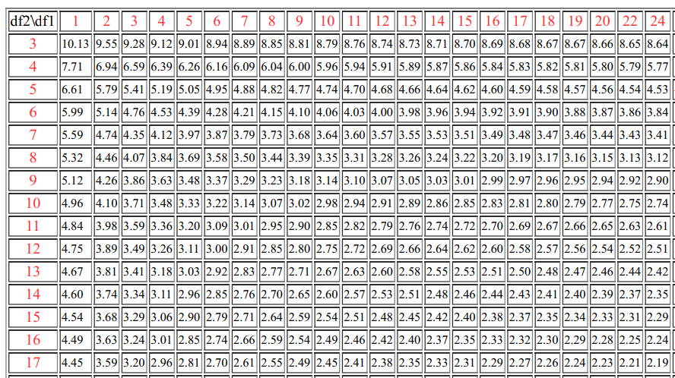

Slide 33
Two-Way ANOVA (Factorial Analysis)
The two-way analysis of variance (ANOVA) is an extension of the one-way ANOVA
It examines the influence of two different independent variables on one continuous dependent variable
The primary purpose of a two-way ANOVA is to understand if there is an interaction between the two independent variables on the dependent variable.

Slide 34
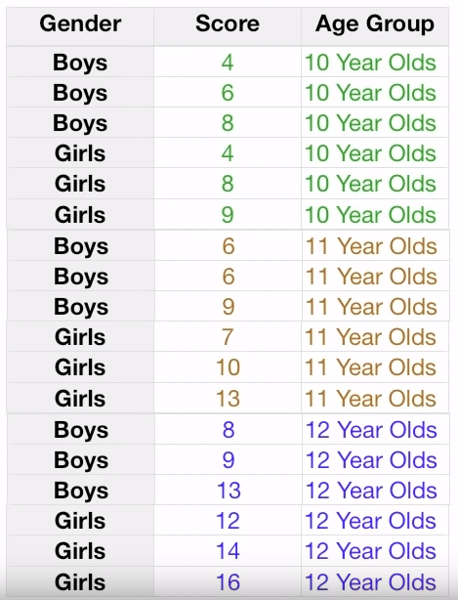
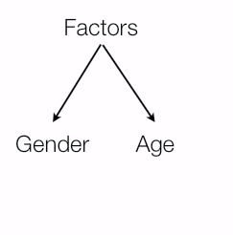

Slide 35
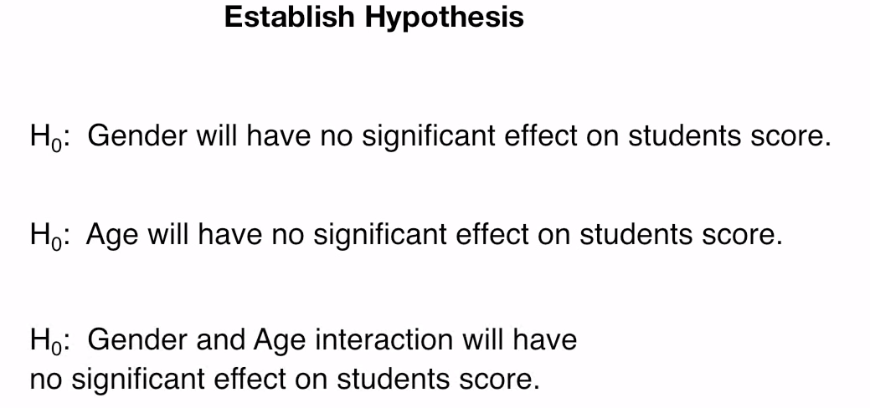

Slide 36
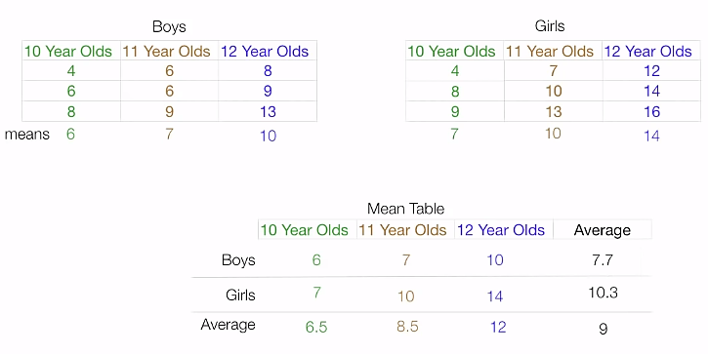

Slide 37
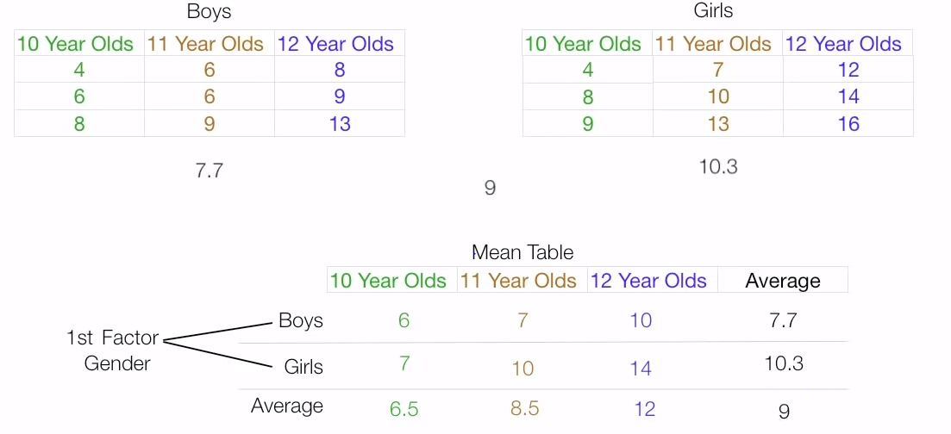

Slide 38
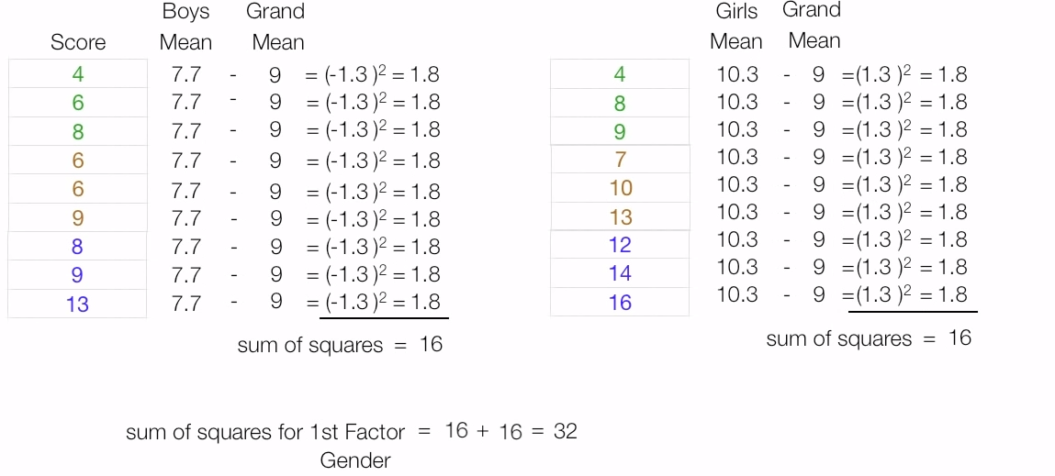
Sum of squares for 1st Factor (Gender)

Slide 39
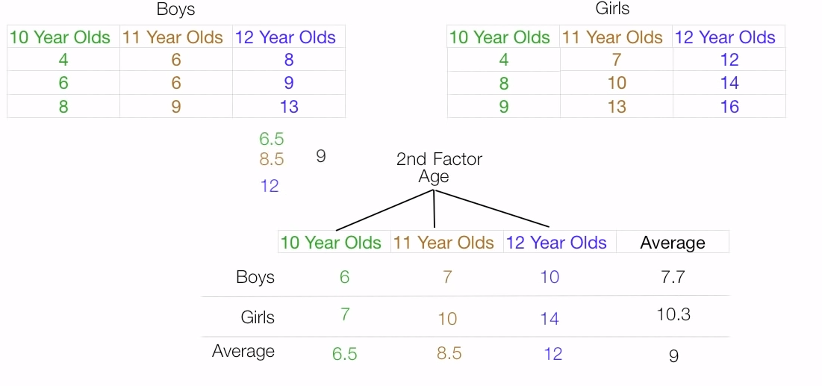
Sum of squares for 2nd Factor (Age)

Slide 40
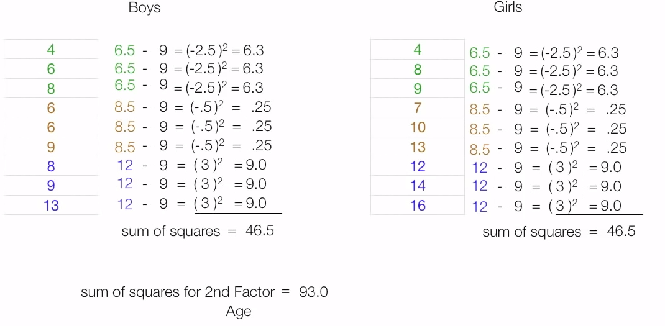
Sum of squares for 2nd Factor (Age)

Slide 41
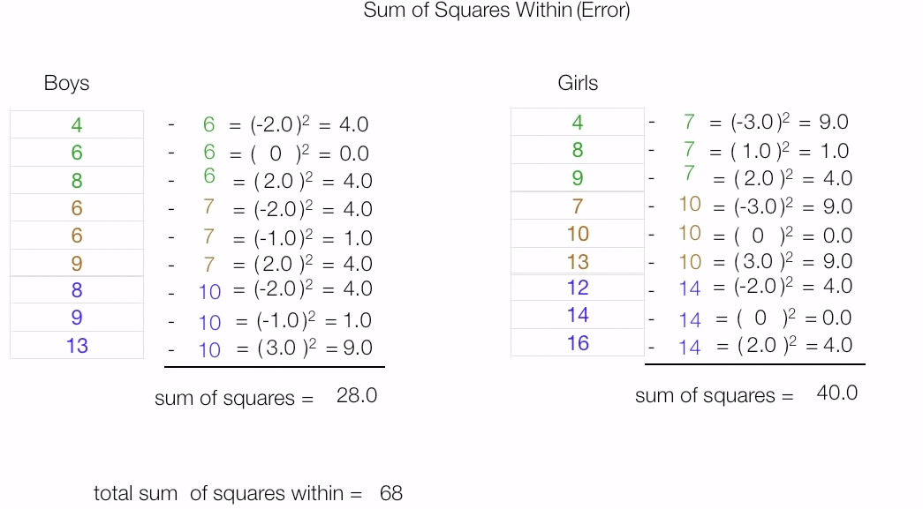
Sum of squares within (Error)

Slide 42
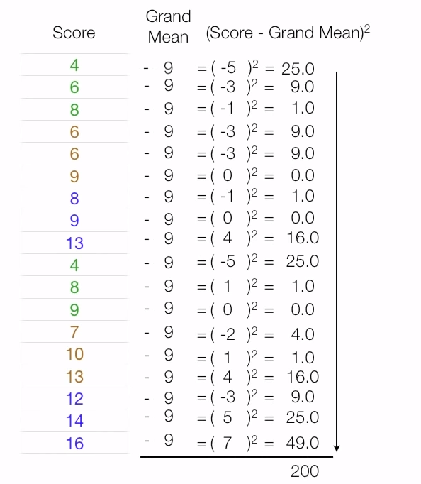
Total sum of square

Slide 43
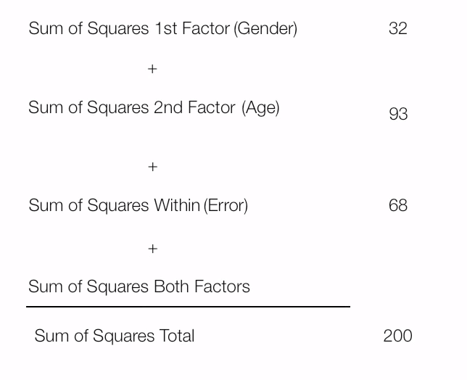

Slide 44
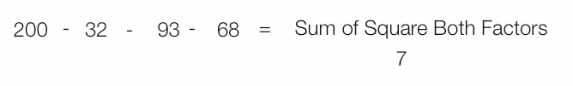

Slide 45
Degrees of freedom
1st factor gender d.f = Number of rows -1 = 2-1 = 1
2nd factor Age d.f = Number of Column -1 = 3-1 = 2
Degree of freedom for sum of square of both factor
= 1st factor gender d.f × 2nd factor Age d.f
= 1 × 2
= 2

Slide 46
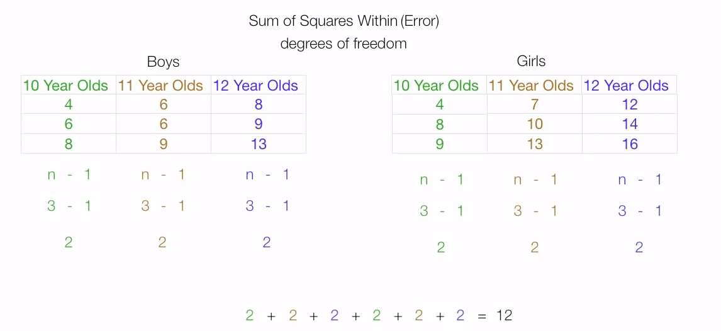

Slide 47
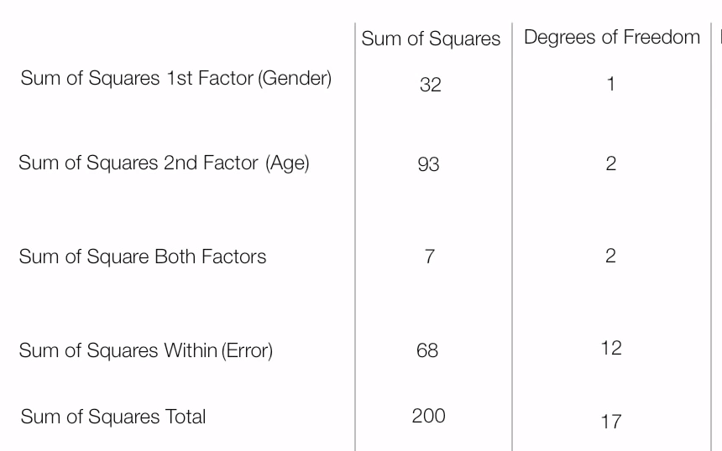

Slide 48
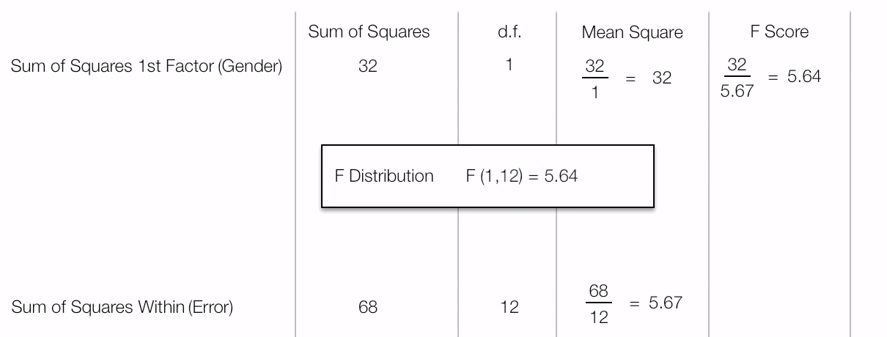

Slide 49
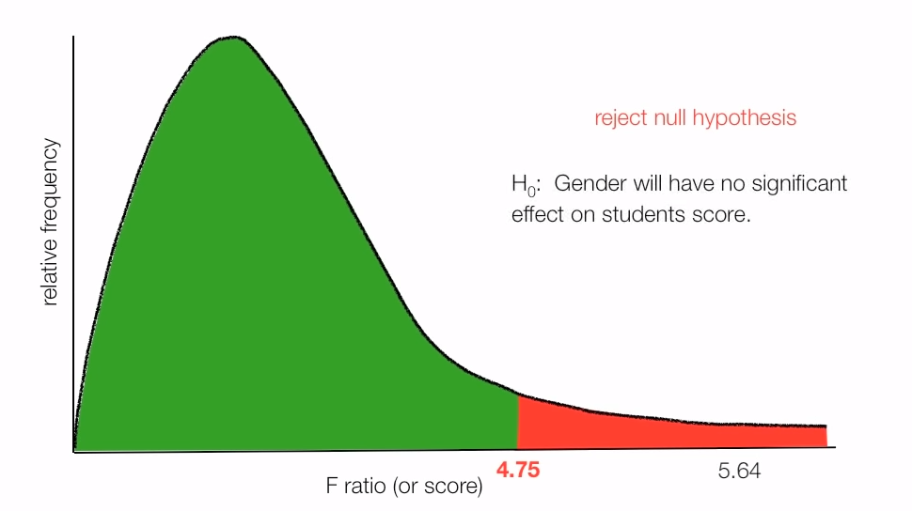

Slide 50
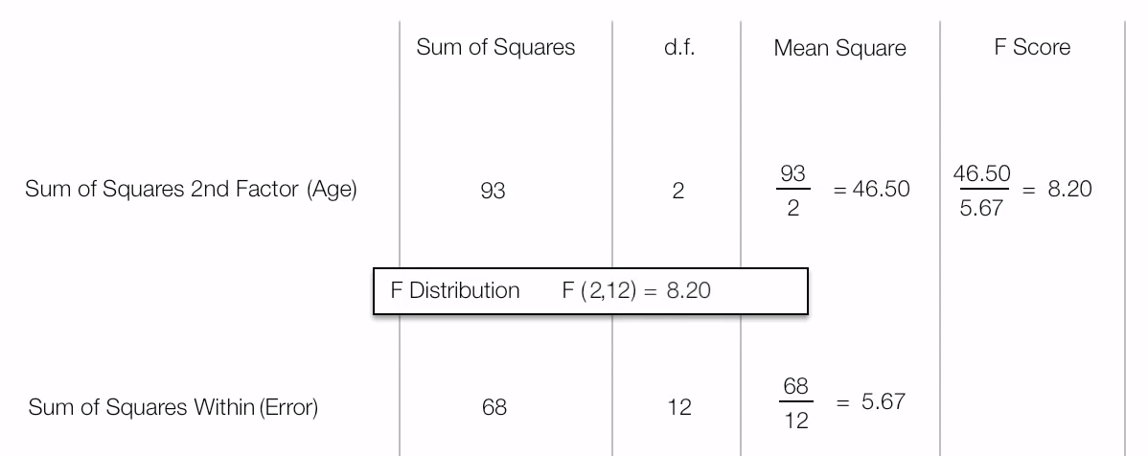

Slide 51
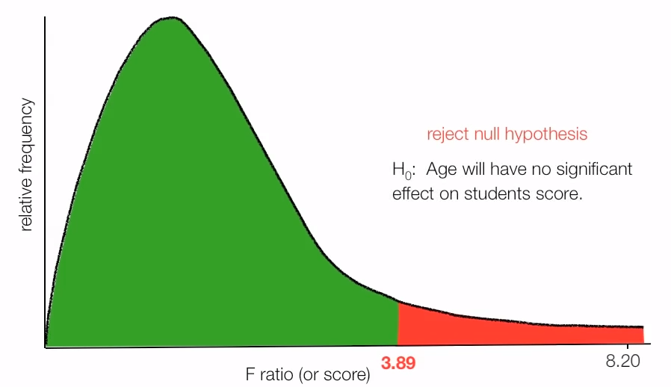

Slide 52
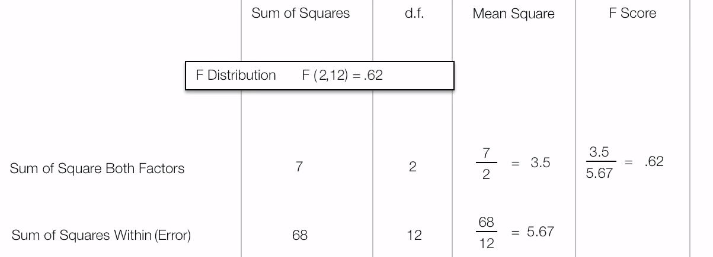

Slide 53
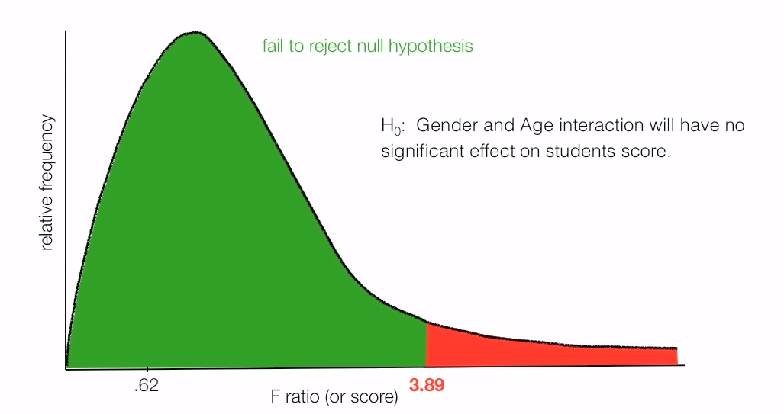

Slide 54
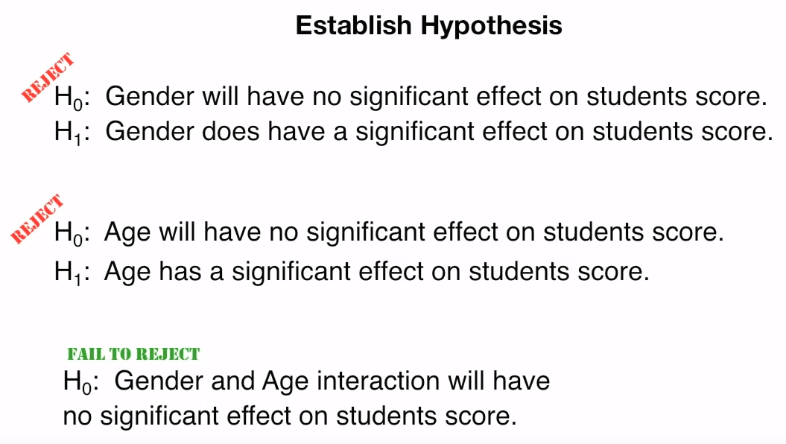

Slide 55
References
http://onlinestatbook.com/2/analysis_of_variance/intro.html
https://en.wikipedia.org/wiki/Analysis_of_variance
https://www.technologynetworks.com/informatics/articles/one-way-vs-two-way-anova-definition-differences-assumptions-and-hypotheses-306553
David Longstreet, https://www.linkedin.com/in/davidlongstreet/
https://www.mathsisfun.com/data/correlation.html

